Slide 1
SECTION 2 Machine Learning Approaches

Slide 2
Chapter 5 Introduction to Machine Learning with Scikit-learn
The modern all-connected world is filled with data.
Machine learning is the science of making computers able to act based on available data without being explicitly programmed to act a certain way.
A computer program is said to learn from experience E with respect to some class of tasks T and performance measure P, if its performance at tasks in T, as measured by P, improves with experience E.
—Tom Mitchell

Slide 3
A robotic agent that classifies whether the selected email is a spam or not looks at a well-annotated repository of previous emails that contains the label mentioning whether a given email is a spam or not.
An agent playing a game of chess observes the thousands of games played in the past that act as the experience while also noticing which moves attributed to a victory.
We will explore the basics of machine learning and its broad categories and applications.
A discussion of Scikit-learn, the most popular library used for machine learning which will be the primary focus of this section of the book.

Slide 4
Learning from Data
A general notion of machine learning is to focus on the process of learning from data to discover hidden patterns or predict future events.
There are two basic approaches within machine learning, namely, supervised learning and unsupervised learning.
The main difference is one uses labelled data to help predict outcomes while the other does not.

Slide 5
Supervised Learning
Supervised learning is the set of approaches that requires an explicit label containing the correct expected output for each row in the data through which we want to learn.
These labels are either written by hand by domain experts or obtained from previous records or generated by software logs.

Slide 6
Classification
Classification is a suite of supervised learning methods that aim to assign a discrete class label chosen out of a predefined limited set of options (two or more).
An example of such labels is a system that monitors the financial transactions and validates each transaction for any kind of fraud.
Another common example is a sentiment analysis system that takes input text and learns how to classify the given text as “positive,” “negative,” or “neutral.”

Slide 7
Regression
Regression is a supervised learning technique that tries to capture the relationship between two variables.
We often have one or more independent variables, or the variables that we would always know, and we want to learn how to predict the value of a dependent variable.
In regression problems, we want to predict a continuous real value; that means the target value can have infinite possibilities unlike classification that has a selected few.

Slide 8
An example of regression is a system to predict the value of a stock the next day based on the value and volume traded on the previous day.
Supervised learning is specifically used in prediction problems where you want to obtain the output for the given data based on past experiences. It is used in use cases like image categorization, sentiment analysis, spam filtering, etc.

Slide 9
Unsupervised Learning
Unsupervised learning is the set of approaches that focus on finding hidden patterns and insights from the given dataset.
In such cases, we do not require labelled data.
The goal of such approaches is to find the underlying structure of the data, simplify or compress the dataset, or group the data according to inherent similarities.

Slide 10
One common task in unsupervised learning is clustering, which is a method of grouping data points (or objects) into clusters so that the objects that are similar to each other are assigned to one group while making sure that they are significantly different from the items present in other groups.
Another unsupervised learning approach tries to identify the items that often occur together in the dataset – for example, for a supermarket, it can discover the patterns like bread and milk are often brought together.

Slide 11
Structure of a Machine Learning System
The first part is usually an offline process, which often involves the training, in which we process the real-world data to learn certain parameters that can help predict the results and discover the patterns in previously unseen data.
The second part is the online process, which involves the prediction phase, in which we leverage the parameters we have learned before and find the results in previously unseen data.

Slide 12
Based on the quality of results we have obtained as a result, we may decide to make modifications, add more data, and restart the whole process. Such a process, with the help of thorough evaluation metrics, hyperparameter tuning methodologies, and the right choice of features, iteratively produces better and better results.

Slide 13
The whole end-to-end process that is involved can be generalized into a six-stage process outlined here and shown in Figure 5-1:
  Problem Understanding
  Data Collection
  Data Annotation and Data Preparation
  Data Wrangling
  Model Development, Training, and Evaluation
  Model Deployment and Maintenance

Slide 14
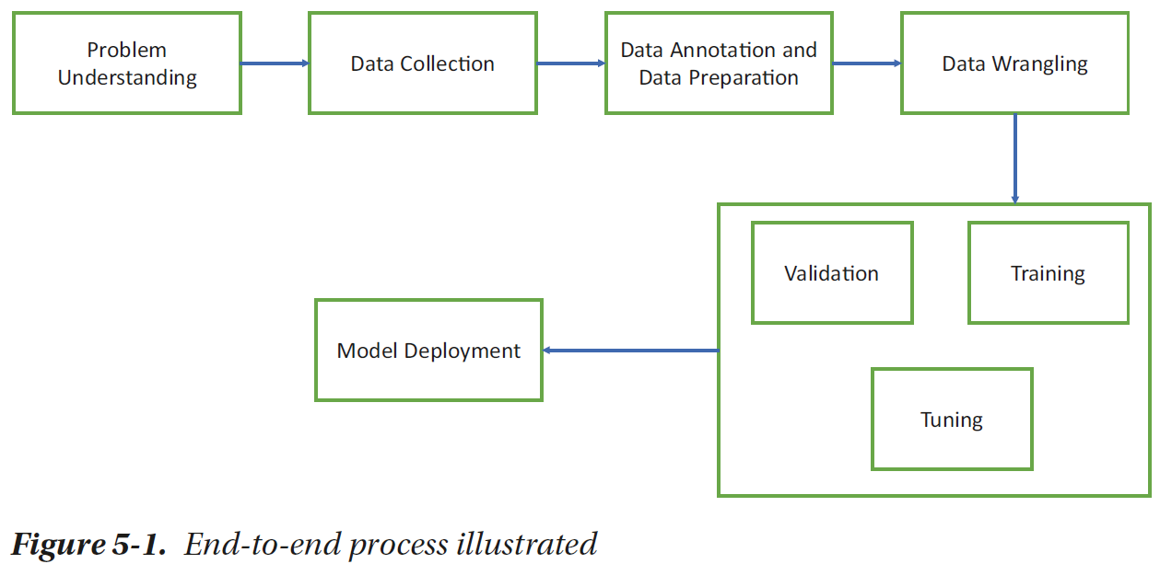

Slide 15
Problem Understanding
Before writing your first line of code, you need to have a thorough understanding of the problem you are trying to solve.
This requires discussions with multiple stakeholders and opening the conversations about the right scope of the problems.

Slide 16
Data Collection
Once the problem is clear and the right scope has been defined, we can begin to collect the data.
Data may come from machine logs, user logs, transaction records, etc.
For many use cases, you can initially search for open source or publicly available datasets that are often shared in public forums or government websites.
Remember, machine learning is powered by the data. The quality of end results will almost always depend on the quantity and the quality of the data.

Slide 17
Data Annotation and Data Preparation
The raw data that you thus obtain might not always be ready to be used.
In case you are working with a supervised problem, you might require a person or a team to assign the correct labels to your data.
Data preparation might also require data cleaning, reformatting, and normalization.

Slide 18
Data Wrangling
In all the algorithms that we would study in the future chapters, you will notice that there is an expected format in which they require the data.
In general, we want to convert or transform the data from any format into vectors containing numbers.

Slide 19
Model Development, Training, and Evaluation
In most of the cases, we will leverage existing implementations of algorithms that are already provided in popular packages like Scikit-learn, TensorFlow, PyTorch, etc.
The well-formatted data is then sent to the algorithm for training, during which the model is prepared, which is often a set of parameters or weights related to a predefined set of equations or a graph.

Slide 20
Training usually happens in conjunction with testing over multiple iterations till a model of reliable quality is obtained as shown in Figure 5-2.
You will learn the model parameters using a major proportion of the available data and use the same parameters to predict the results for the remaining portion.
This is done to evaluate how well your model performs with previously unseen data. Such performance measures can help you improve it by tuning the necessary hyperparameters.

Slide 21
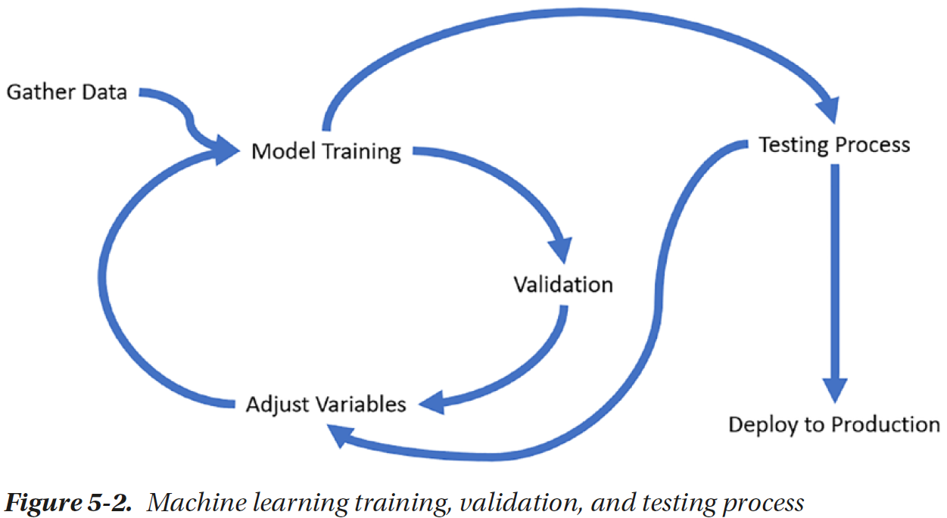

Slide 22
Model Deployment
Once you have created a model that is ready for inference, you have to make it work as a building block that can be integrated in the production environment.
As the model is deployed, it will see the new data and predict the values for it. In some cases, it might be possible to collect the new data and build an improved version of dataset for future iterations.

Slide 23
Scikit-Learn
Scikit-learn is a highly popular library for machine learning that provides ready-to-use implementations of various supervised and unsupervised machine learning algorithms through a simple and consistent interface.
It is built upon the SciPy stack, which involves NumPy, SciPy, Matplotlib, Pandas, etc.

Slide 24
Installing Scikit-Learn
Create a new cell in Jupyter Notebook and run the following:
  import sklearn
If you didn’t get any message in the output, you already have Scikit-learn installed.
If not, run the following command to install:
  !pip install scikit-learn
Another alternate highly recommended way is to install a distribution that provides the complete stack required for such projects through an easy-to-configure interface that allows you highly customized virtual environments. One such popular distribution is Anaconda.

Slide 25
Understanding the API
One primary reason for popularity and growth of Scikit-learn is the simplicity of use despite the powerful implementation.
Machine learning methods expect the data to be present in sets of numerical variables called features.
These numerical values can be represented as a vector and implemented as a NumPy array.
NumPy provides efficient vectorized operations while keeping the code simple and short.

Slide 26
Scikit-learn is organized around three primary APIs, namely, estimator, predictor, and transformer.

Slide 27
Estimators are the core interface implemented by classification, regression, clustering, feature extraction, and dimensionality reduction methods.
An estimator is initialized from hyperparameter values and implements the actual learning process in the fit method, which you call while providing the input data and labels in the form of X_train and y_train arrays.

Slide 28
Predictors provide a predict method to take the data which needs to be predicted through a NumPy array that we usually refer to as X_test.
Transformer interfaces implement the mechanism to transform the given data in the form of NumPy array through the preprocessing and feature extraction stages.

Slide 29
Several algorithm implementations in Scikit-learn implement one or more of these three interfaces. Some methods can be chained to perform multiple tasks in a single line of code.
This can be further simplified with the use of Pipeline objects that chain multiple estimators into a single one.
  pipe = Pipeline([('scaler', StandardScaler()), ('svc', SVC())])

Slide 30
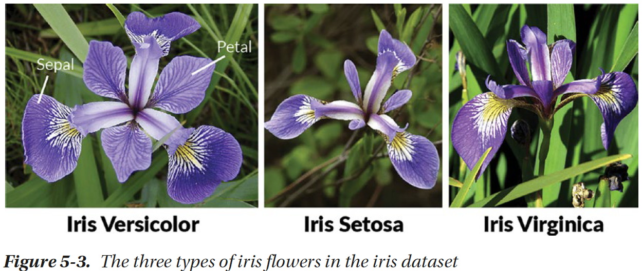
Your First Scikit-learn Experiment
A short hello-world experiment with Scikit-learn.
We will use a simple dataset called iris dataset that contains the petal and sepal length of three varieties of iris flowers (Figure 5-3).

Slide 31
Scikit-learn comes with some datasets ready for use.
  from sklearn import datasets
  iris = datasets.load_iris()
  print (iris)
  print (iris.keys())
You should be able to see the components of iris object as a dictionary, which includes the following keys: ‘data’, ‘target’, ‘frame’, ‘target_names’, ‘DESCR’, ‘feature_names’, and ‘filename’. Right now, data, target and target_names, and feature_names are of interest to us.

Slide 32
Data contains a 2D NumPy array that contains 150 rows and four columns. Target contains 150 items containing the numbers 0, 1, and 2 referring to the target_names, which are ‘setosa’, ‘versicolor’, and ‘virginica’, the three varieties of iris flowers. Feature_names contains the meaning of four columns that are contained in the data.
  from sklearn import datasets
  iris = datasets.load_iris()
  print (iris.data[:10])
  print (iris.target[:5])
  print (iris.feature_names)
  print (iris.target_names)

Slide 33
We will now create an estimator with an algorithm called Support Vector Machines (SVM) Classifier that we will study in detail in a dedicated chapter.
  from sklearn import svm
  clf = svm.SVC(gamma=0.001, C=100.)
  clf.fit(iris.data[:-1], iris.target[:-1])
  print (clf.predict(iris.data))
  print(iris.target)

Slide 34
In this example, we first imported the Support Vector Machines module from Scikit-learn that contains the implementation of the estimator that we wanted to use in this example.
This estimator, svm.SVC, is initialized with two hyperparameters, namely, gamma and C with standard values.
In the next line, we instruct the clf estimator object to learn the parameters using the fit() function that usually takes two parameters, input data, and the corresponding target classes.

Slide 35
In this process, the SVM will learn the necessary parameters, that is, the boundary lines based on which it can divide the three classes – 0, 1, and 2, referring to Iris setosa, Iris virginica, and Iris versicolor.
In the last line, we use the predict() method of the predictor to print the predicted targets for the original dataset according to the model that has been learned.
Note the minor inconsistencies in the predicted results – the couple of records that have been inconsistently marked. These are the predicted results, not the actual targets present in the data.

Slide 36
Summary
Obtained a top-level picture of AI and machine learning.
Explored the ML development process.
Understood the basics of Scikit-learn API.
Other chapters in the next section will discuss machine learning algorithms in detail and discuss the insights on tuning the tools to get the best possible results.

